Slide 1
Chapter 3
Data Modeling Using the Entity-Relationship (ER) Model
Copyright © 2007 Ramez Elmasri and Shamkant B. Navathe

Slide 2
Chapter Outline
Overview of Database Design Process
Example Database Application (COMPANY)
ER Model Concepts
  Entities and Attributes
  Entity Types, Value Sets, and Key Attributes
  Relationships and Relationship Types
  Weak Entity Types
  Roles and Attributes in Relationship Types
ER Diagrams - Notation
ER Diagram for COMPANY Schema
Alternative Notations – UML class diagrams, others
Slide 3- <number>

Slide 3
Overview of Database Design Process
Two main activities:
  Database design
  Applications design
Focus in this chapter on database design
  To design the conceptual schema for a database application
Applications design focuses on the programs and interfaces that access the database
  Generally considered part of software engineering
Slide 3- <number>

Slide 4

Overview of Database Design Process
Slide 3- <number>

Slide 5
Example COMPANY Database
We need to create a database schema design based on the following (simplified) requirements of the COMPANY Database:
  The company is organized into DEPARTMENTs. Each department has a name, number and an employee who manages the department. We keep track of the start date of the department manager. A department may have several locations.
  Each department controls a number of PROJECTs. Each project has a unique name, unique number and is located at a single location.
Slide 3- <number>

Slide 6
Example COMPANY Database (Contd.)
  We store each EMPLOYEE’s social security number, address, salary, sex, and birthdate.
    Each employee works for one department but may work on several projects.
    We keep track of the number of hours per week that an employee currently works on each project.
    We also keep track of the direct supervisor of each employee.
  Each employee may have a number of DEPENDENTs.
    For each dependent, we keep track of their name, sex, birthdate, and relationship to the employee.
Slide 3- <number>

Slide 7
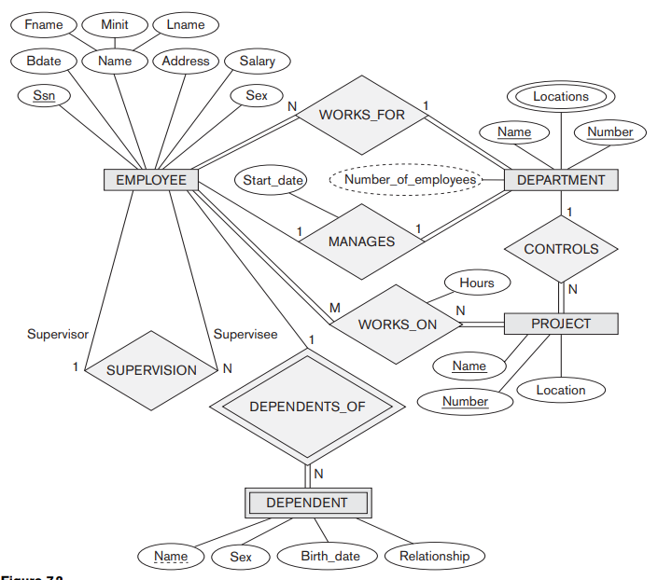
Example COMPANY Database (Contd.)
Slide 3- <number>

Slide 8
ER Model Concepts
Entities and Attributes
  Entities are specific objects or things in the mini-world that are represented in the database.
    For example the EMPLOYEE John Smith, the Research DEPARTMENT, the ProductX PROJECT
  Attributes are properties used to describe an entity.
    For example an EMPLOYEE entity may have the attributes Name, SSN, Address, Sex, BirthDate
  A specific entity will have a value for each of its attributes.
    For example a specific employee entity may have Name='John Smith', SSN='123456789', Address ='731, Fondren, Houston, TX', Sex='M', BirthDate='09-JAN-55‘
  Each attribute has a value set (or data type) associated with it – e.g. integer, string, subrange, enumerated type, …
Slide 3- <number>

Slide 9

Summary of notation for ER diagrams
Slide 3- <number>

Slide 10
Types of Attributes (1)
Simple
  Each entity has a single atomic value for the attribute. For example, SSN or Gender.
Composite
  The attribute may be composed of several components. For example:
    Address(Apt#, House#, Street, City, State, ZipCode, Country), or
    Name(FirstName, MiddleName, LastName).
    Composition may form a hierarchy where some components are themselves composite.
Multi-valued
  An entity may have multiple values for that attribute. For example, Color of a CAR or PreviousDegrees of a STUDENT.
    Denoted as {Color} or {PreviousDegrees}.
Null valued: Flat number exists only for apartment
Stored and Derived: Age from birthdate
Complex : For example, if a person can have more than one residence and each residence can have a single address
Slide 3- <number>

Slide 11

Example of a composite attribute
Slide 3- <number>

Slide 12
Types of Attributes (2)
Complex Attributes:In general, composite and multi-valued attributes may be nested arbitrarily to any number of levels, although this is rare.
  For example, PreviousDegrees of a STUDENT is a composite multi-valued attribute denoted by {PreviousDegrees (College, Year, Degree, Field)}
  Multiple PreviousDegrees values can exist
  Each has four subcomponent attributes:
    College, Year, Degree, Field
Slide 3- <number>

Slide 13
Entity Types and Key Attributes (1)
Entities with the same basic attributes are grouped or typed into an entity type.
  For example, the entity type EMPLOYEE and PROJECT.
An attribute of an entity type for which each entity must have a unique value is called a key attribute of the entity type.
  For example, SSN of EMPLOYEE.
Slide 3- <number>

Slide 14
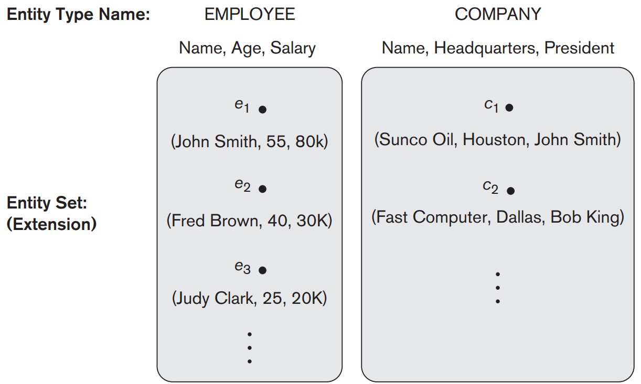
Entity Types and Key Attributes (1)
Slide 3- <number>

Slide 15
Entity Types and Key Attributes (2)
A key attribute may be composite.
  VehicleTagNumber is a key of the CAR entity type with components (Number, State).
An entity type may have more than one key.
  The CAR entity type may have two keys:
    VehicleIdentificationNumber (popularly called VIN)
    VehicleTagNumber (Number, State), aka license plate number.
Each key is underlined
Slide 3- <number>

Slide 16
Displaying an Entity type
In ER diagrams, an entity type is displayed in a rectangular box
Attributes are displayed in ovals
  Each attribute is connected to its entity type
  Components of a composite attribute are connected to the oval representing the composite attribute
  Each key attribute is underlined
  Multivalued attributes displayed in double ovals
See CAR example on next slide
Slide 3- <number>

Slide 17

Entity Type CAR with two keys and a corresponding Entity Set
Slide 3- <number>

Slide 18
Entity Set
Each entity type will have a collection of entities stored in the database
  Called the entity set
Previous slide shows three CAR entity instances in the entity set for CAR
Same name (CAR) used to refer to both the entity type and the entity set
Entity set is the current state of the entities of that type that are stored in the database
Slide 3- <number>

Slide 19
Initial Design of Entity Types for the COMPANY Database Schema
Based on the requirements, we can identify four initial entity types in the COMPANY database:
  DEPARTMENT
  PROJECT
  EMPLOYEE
  DEPENDENT
Their initial design is shown on the following slide
The initial attributes shown are derived from the requirements description
Slide 3- <number>

Slide 20

Initial Design of Entity Types:
EMPLOYEE, DEPARTMENT, PROJECT, DEPENDENT
Slide 3- <number>

Slide 21
Refining the initial design by introducing relationships
The initial design is typically not complete
Some aspects in the requirements will be represented as relationships
ER model has three main concepts:
  Entities (and their entity types and entity sets)
  Attributes (simple, composite, multivalued)
  Relationships (and their relationship types and relationship sets)
We introduce relationship concepts next
Slide 3- <number>

Slide 22
Relationships and Relationship Types (1)
A relationship relates two or more distinct entities with a specific meaning.
  For example, EMPLOYEE John Smith works on the ProductX PROJECT, or EMPLOYEE Franklin Wong manages the Research DEPARTMENT.
Relationships of the same type are grouped or typed into a relationship type.
  For example, the WORKS_ON relationship type in which EMPLOYEEs and PROJECTs participate, or the MANAGES relationship type in which EMPLOYEEs and DEPARTMENTs participate.
The degree of a relationship type is the number of participating entity types.
  Both MANAGES and WORKS_ON are binary relationships.
Slide 3- <number>

Slide 23

Relationship instances of the WORKS_FOR N:1 relationship between EMPLOYEE and DEPARTMENT
Slide 3- <number>

Slide 24

Relationship instances of the M:N WORKS_ON relationship between EMPLOYEE and PROJECT
Slide 3- <number>

Slide 25
Relationship type vs. relationship set (1)
Relationship Type:
  Is the schema description of a relationship
  Identifies the relationship name and the participating entity types
  Also identifies certain relationship constraints
Relationship Set:
  The current set of relationship instances represented in the database
  The current state of a relationship type
Slide 3- <number>

Slide 26
Relationship type vs. relationship set (2)
Previous figures displayed the relationship sets
Each instance in the set relates individual participating entities – one from each participating entity type
In ER diagrams, we represent the relationship type as follows:
  Diamond-shaped box is used to display a relationship type
  Connected to the participating entity types via straight lines
Slide 3- <number>

Slide 27
Refining the COMPANY database schema by introducing relationships
By examining the requirements, six relationship types are identified
All are binary relationships( degree 2)
Listed below with their participating entity types:
  WORKS_FOR (between EMPLOYEE, DEPARTMENT)
  MANAGES (also between EMPLOYEE, DEPARTMENT)
  CONTROLS (between DEPARTMENT, PROJECT)
  WORKS_ON (between EMPLOYEE, PROJECT)
  SUPERVISION (between EMPLOYEE (as subordinate), EMPLOYEE (as supervisor))
  DEPENDENTS_OF (between EMPLOYEE, DEPENDENT)
Slide 3- <number>

Slide 28

ER DIAGRAM – Relationship Types are:
WORKS_FOR, MANAGES, WORKS_ON, CONTROLS, SUPERVISION, DEPENDENTS_OF
Slide 3- <number>

Slide 29
Discussion on Relationship Types
In the refined design, some attributes from the initial entity types are refined into relationships:
  Manager of DEPARTMENT -> MANAGES
  Works_on of EMPLOYEE -> WORKS_ON
  Department of EMPLOYEE -> WORKS_FOR
  etc
In general, more than one relationship type can exist between the same participating entity types
  MANAGES and WORKS_FOR are distinct relationship types between EMPLOYEE and DEPARTMENT
  Different meanings and different relationship instances.
Slide 3- <number>

Slide 30
Recursive Relationship Type
An relationship type whose with the same participating entity type in distinct roles
Example: the SUPERVISION relationship
EMPLOYEE participates twice in two distinct roles:
  supervisor (or boss) role
  supervisee (or subordinate) role
Each relationship instance relates two distinct EMPLOYEE entities:
  One employee in supervisor role
  One employee in supervisee role
Slide 3- <number>

Slide 31
Weak Entity Types
An entity that does not have a key attribute
A weak entity must participate in an identifying relationship type with an owner or identifying entity type
Entities are identified by the combination of:
  A partial key of the weak entity type
  The particular entity they are related to in the identifying entity type
Example:
  A DEPENDENT entity is identified by the dependent’s first name, and the specific EMPLOYEE with whom the dependent is related
  Name of DEPENDENT is the partial key
  DEPENDENT is a weak entity type
  EMPLOYEE is its identifying entity type via the identifying relationship type DEPENDENT_OF
Slide 3- <number>

Slide 32
Constraints on Relationships
Constraints on Relationship Types
  (Also known as ratio constraints)
  Cardinality Ratio (specifies maximum participation)
    One-to-one (1:1)
    One-to-many (1:N) or Many-to-one (N:1)
    Many-to-many (M:N)
  Existence Dependency Constraint (specifies minimum participation) (also called participation constraint)
    zero (optional participation, not existence-dependent)
    one or more (mandatory participation, existence-dependent)
Slide 3- <number>

Slide 33
Many-to-one (N:1) Relationship
Slide 3- <number>

Slide 34
Many-to-many (M:N) Relationship
Slide 3- <number>

Slide 35
Displaying a recursive relationship
In a recursive relationship type.
  Both participations are same entity type in different roles.
  For example, SUPERVISION relationships between EMPLOYEE (in role of supervisor or boss) and (another) EMPLOYEE (in role of subordinate or worker).
In following figure, first role participation labeled with 1 and second role participation labeled with 2.
In ER diagram, need to display role names to distinguish participations.
Slide 3- <number>

Slide 36

A Recursive Relationship Supervision`
Slide 3- <number>

Slide 37
Recursive Relationship Type is: SUPERVISION
(participation role names are shown)
Slide 3- <number>

Slide 38
Attributes of Relationship types
A relationship type can have attributes:
  For example, HoursPerWeek of WORKS_ON
  Its value for each relationship instance describes the number of hours per week that an EMPLOYEE works on a PROJECT.
    A value of HoursPerWeek depends on a particular (employee, project) combination
  Most relationship attributes are used with M:N relationships
    In 1:N relationships, they can be transferred to the entity type on the N-side of the relationship
Slide 3- <number>

Slide 39
Example Attribute of a Relationship Type:
Hours of WORKS_ON
Slide 3- <number>

Slide 40
Notation for Constraints on Relationships
Cardinality ratio (of a binary relationship): 1:1, 1:N, N:1, or M:N
  Shown by placing appropriate numbers on the relationship edges.
Participation constraint (on each participating entity type): total (called existence dependency) or partial.
  Total shown by double line, partial by single line.
NOTE: These are easy to specify for Binary Relationship Types.
Slide 3- <number>

Slide 41
Alternative (min, max) notation for relationship structural constraints:
Specified on each participation of an entity type E in a relationship type R
Specifies that each entity e in E participates in at least min and at most max relationship instances in R
Default(no constraint): min=0, max=n (signifying no limit)
Must have min≤max, min≥0, max ≥1
Derived from the knowledge of mini-world constraints
Examples:
  A department has exactly one manager and an employee can manage at most one department.
    Specify (0,1) for participation of EMPLOYEE in MANAGES
    Specify (1,1) for participation of DEPARTMENT in MANAGES
  An employee can work for exactly one department but a department can have any number of employees.
    Specify (1,1) for participation of EMPLOYEE in WORKS_FOR
    Specify (0,n) for participation of DEPARTMENT in WORKS_FOR
Slide 3- <number>

Slide 42

The (min,max) notation for relationship constraints
Read the min,max numbers next to the entity type and looking away from the entity type
Slide 3- <number>

Slide 43

COMPANY ER Schema Diagram using (min, max) notation
Slide 3- <number>

Slide 44
Some of the Currently Available Automated Database Design Tools
COMPANY | TOOL | FUNCTIONALITY
Embarcadero Technologies | ER Studio | Database Modeling in ER and IDEF1X
 | DB Artisan | Database administration, space and security management
Oracle | Developer 2000/Designer 2000 | Database modeling, application development
Popkin Software | System Architect 2001 | Data modeling, object modeling, process modeling, structured analysis/design
Platinum (Computer Associates) | Enterprise Modeling Suite: Erwin, BPWin, Paradigm Plus | Data, process, and business component modeling
Persistence Inc. | Pwertier | Mapping from O-O to relational model
Rational (IBM) | Rational Rose | UML Modeling & application generation in C++/JAVA
Resolution Ltd. | Xcase | Conceptual modeling up to code maintenance
Sybase | Enterprise Application Suite | Data modeling, business logic modeling
Visio | Visio Enterprise | Data modeling, design/reengineering Visual Basic/C++
Slide 3- <number>

